Slide 1

Lesson no 9
Communication
Signals

Slide 2
CONTENTS
01. Analog modulation
02. Digital modulation
03. Low probability of intercept (LPI) signals

Slide 3
01. Analog modulation

Slide 4
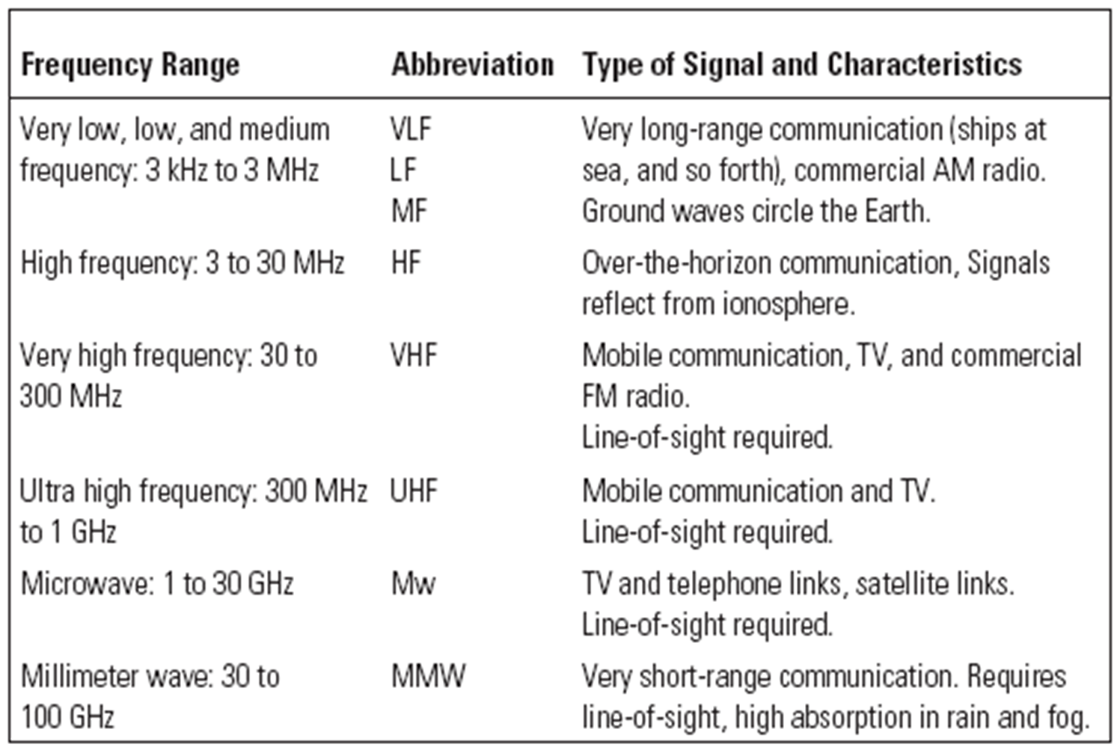

Slide 7
02. Digital modulation

Slide 8
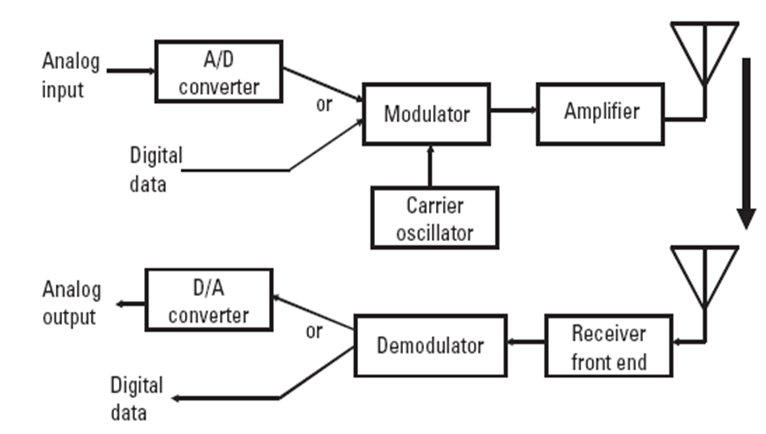

Slide 9
Digital transmission provides several advantages over analog transmission
1. Compatibility with high security encryption;
2. Error-correction coding;
3. LPI techniques;
4. The ability to pass through various transmission paths while retaining high signal quality.

Slide 10
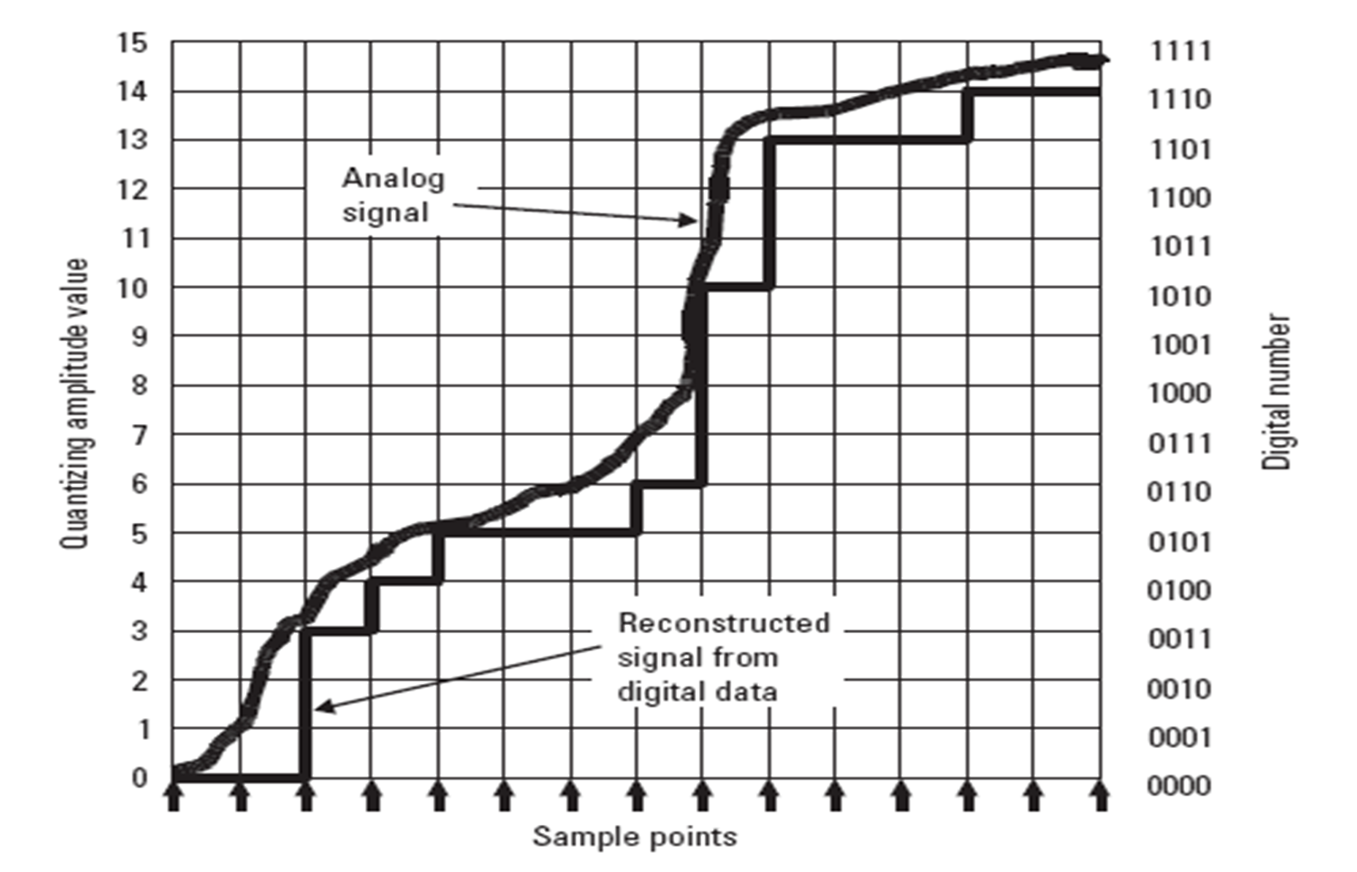

Slide 11
On-off keying (OOK)
Pulse amplitude modulation (PAM)

Slide 12
Frequency shift keying (FSK)

Slide 13
Binary phase shift keying (BPSK)

Slide 14
Quadrature phase shift keying (QPSK)

Slide 16
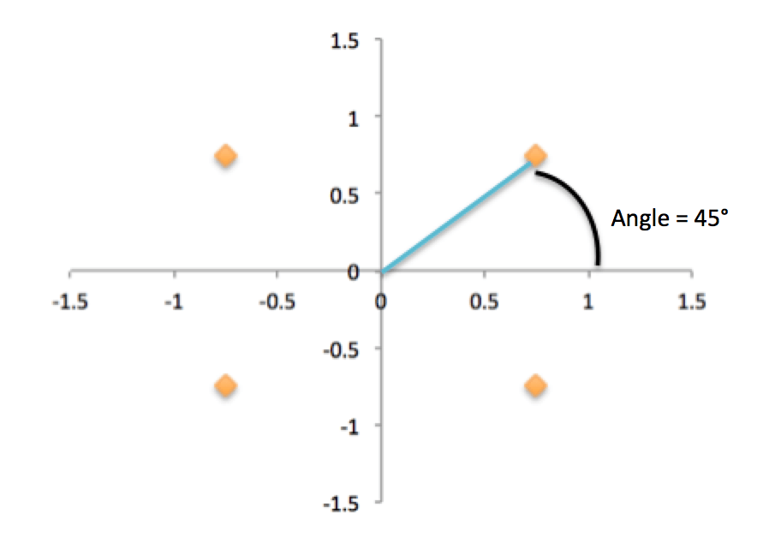
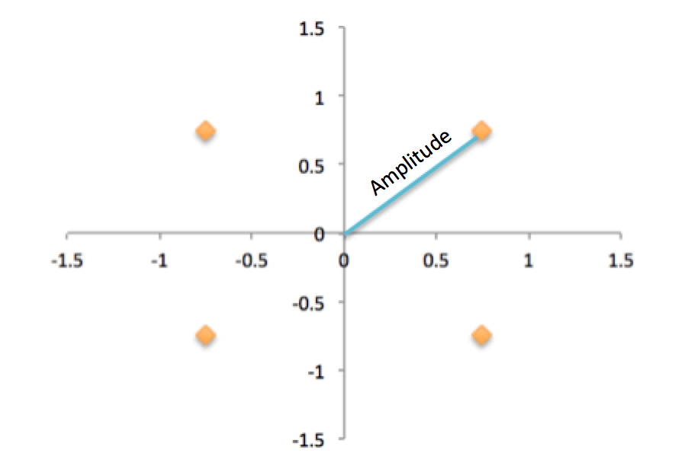
Quadrature amplitude modulation (QAM)

Slide 17
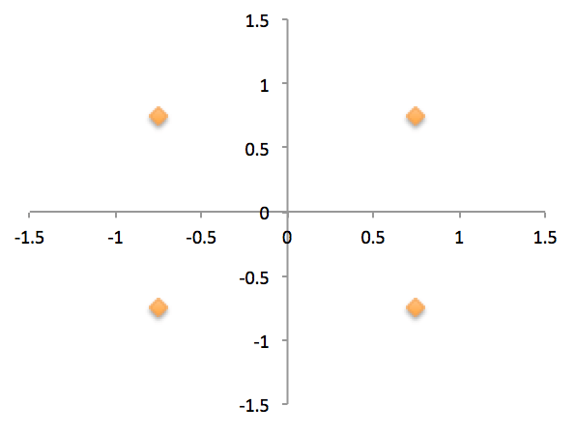
Quadrature amplitude modulation (4-QAM)

Slide 18
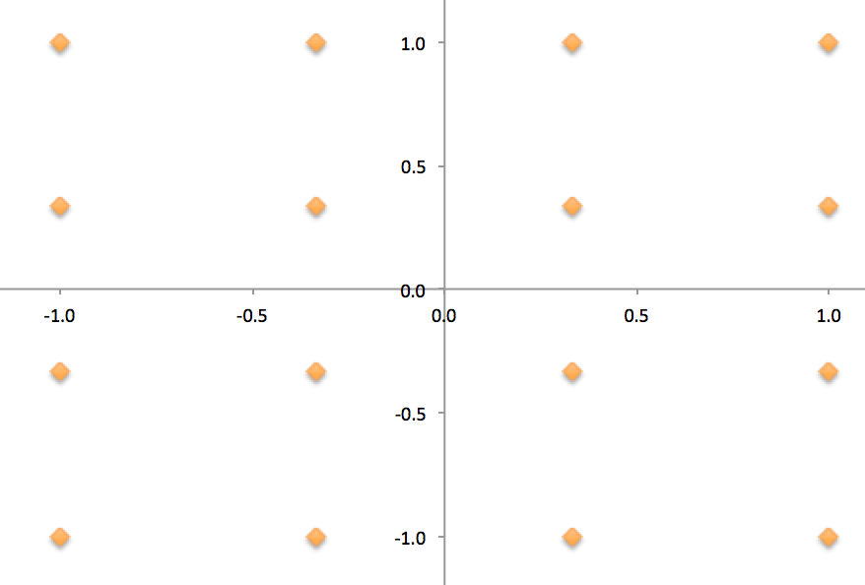
Quadrature amplitude modulation (16-QAM)

Slide 19
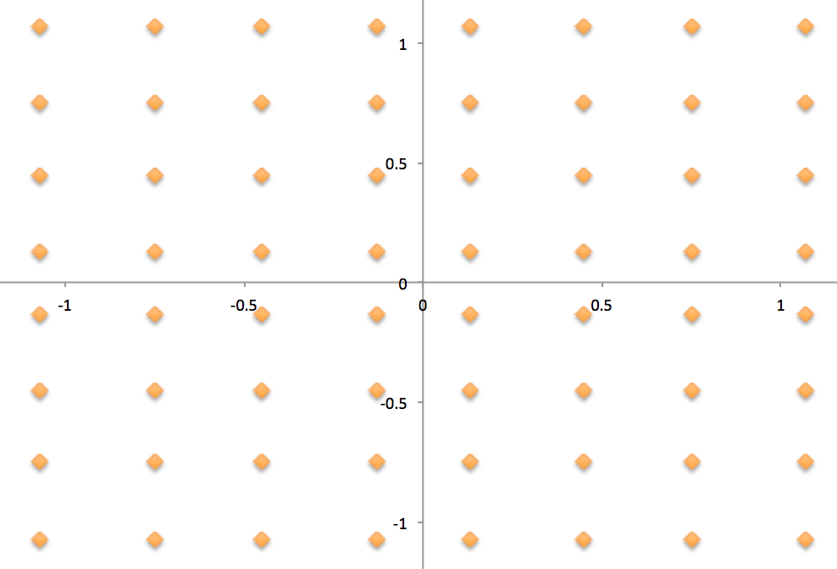
Quadrature amplitude modulation (64-QAM)

Slide 20
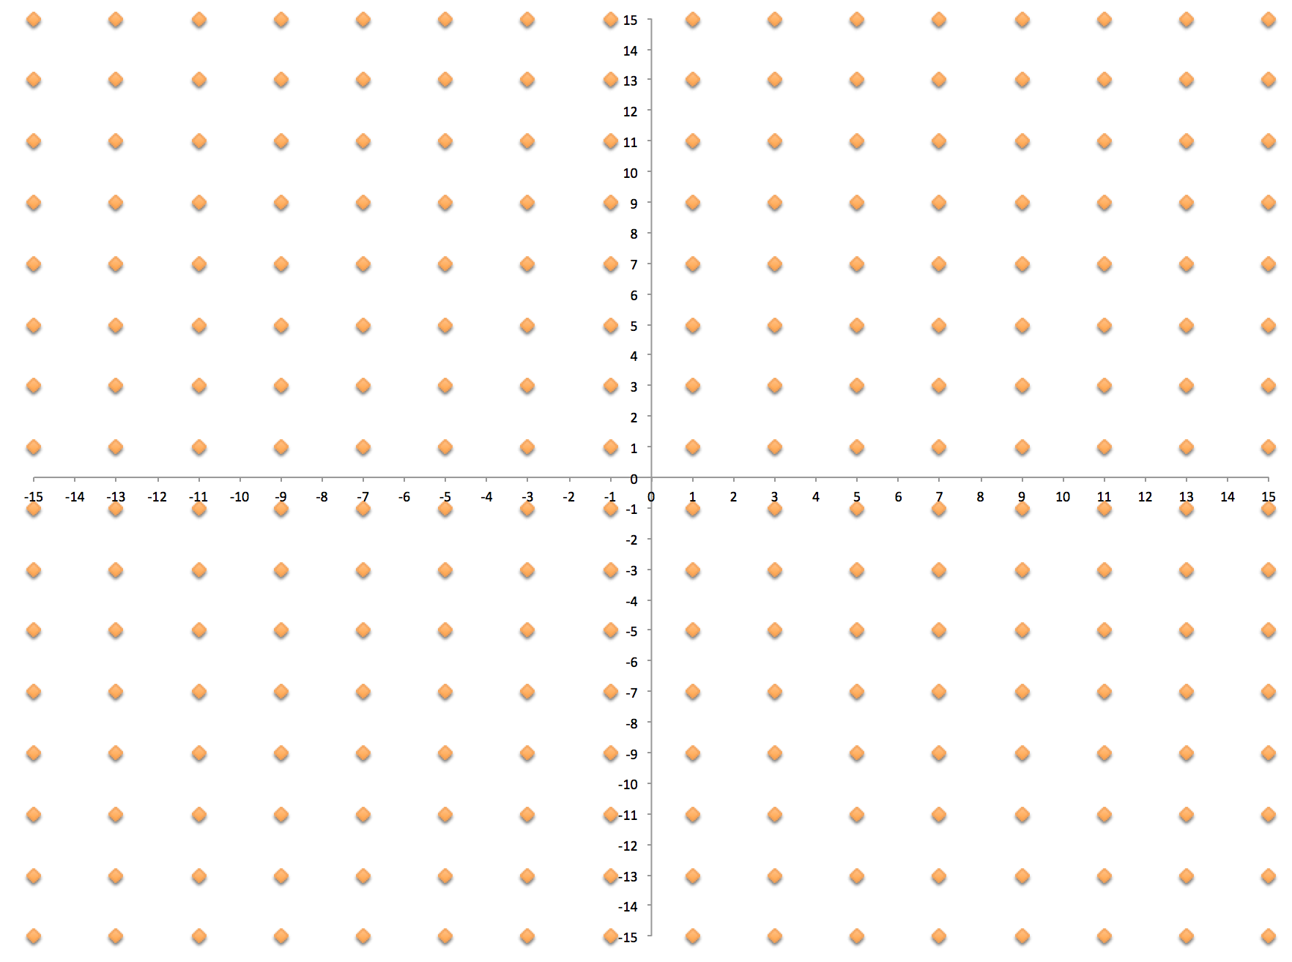
Quadrature amplitude modulation (256-QAM)

Slide 21
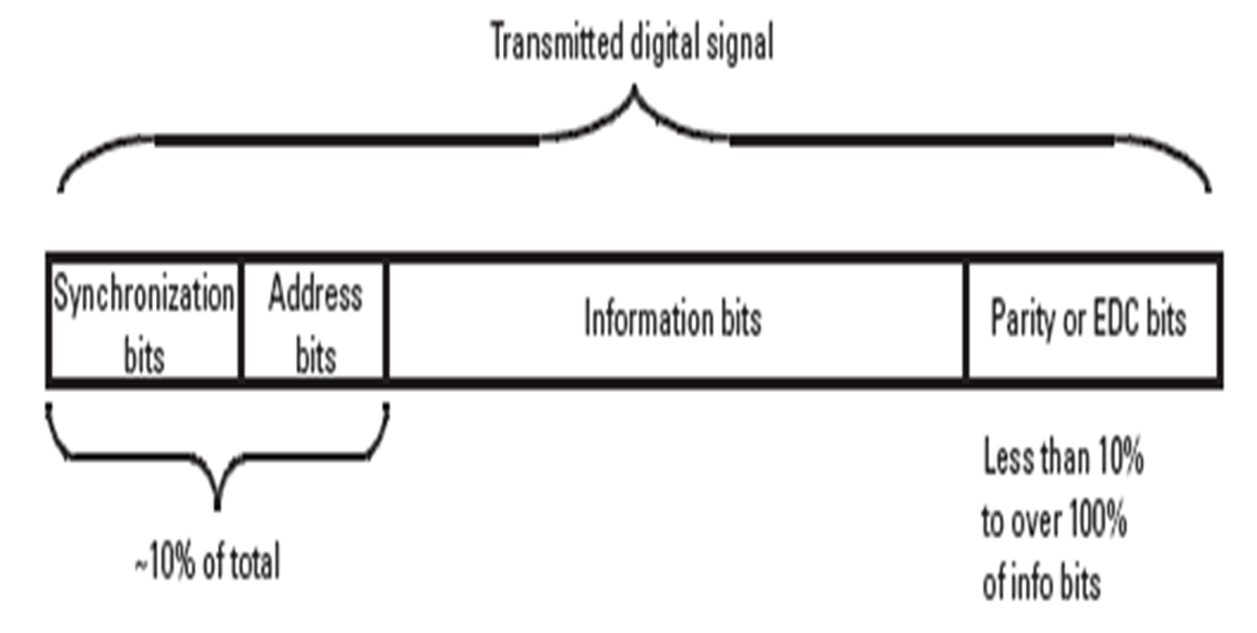
Digital signal structure

Slide 22
03. Low probability of intercept (LPI) signals

Slide 23
Types of LPI signals
            Frequency hopping
            Chirp
            Direct sequence

Slide 24
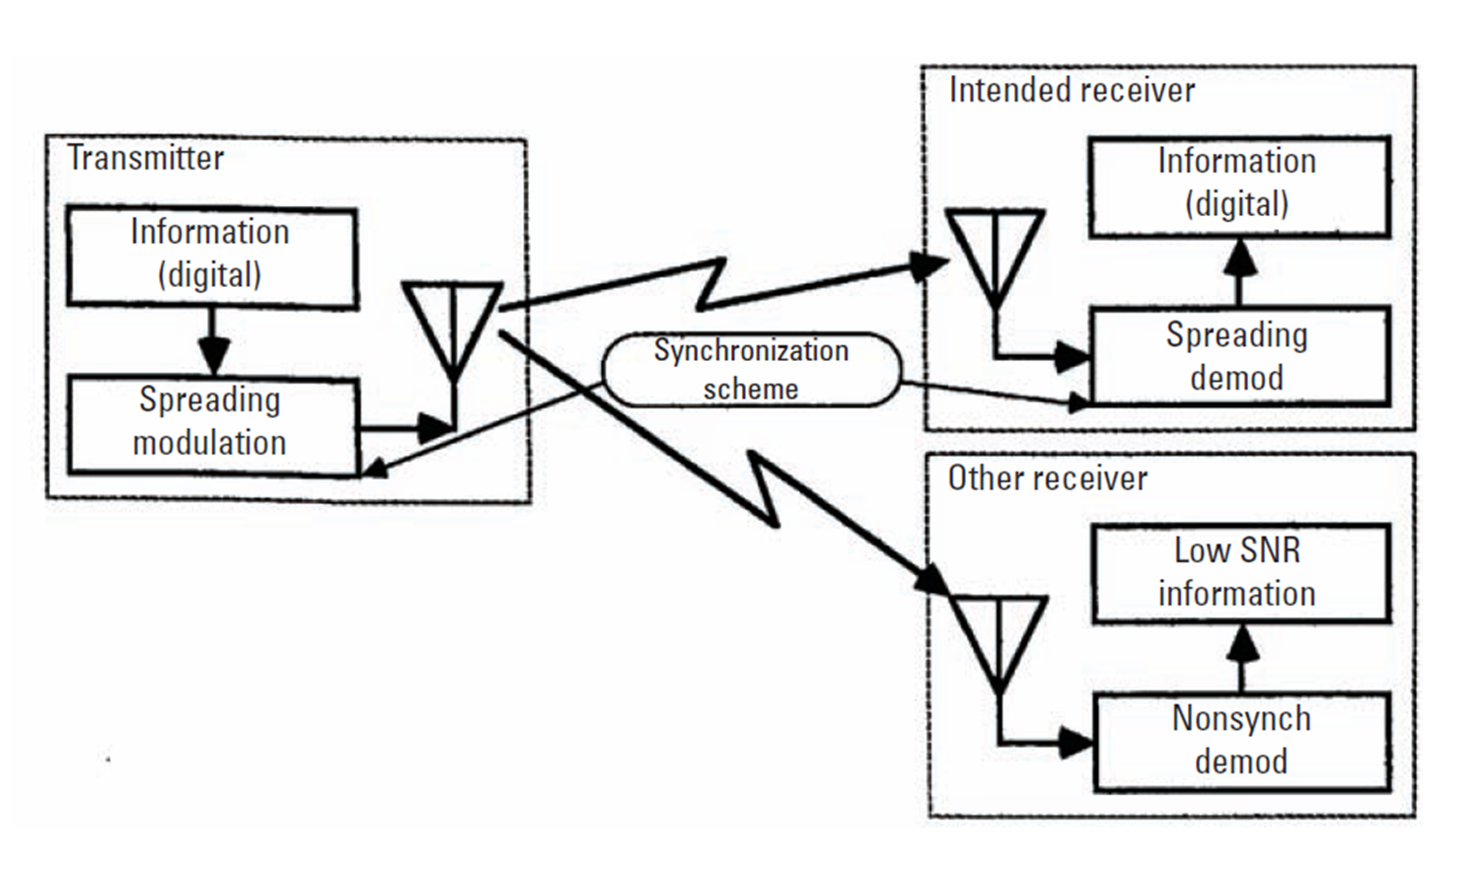

Slide 25
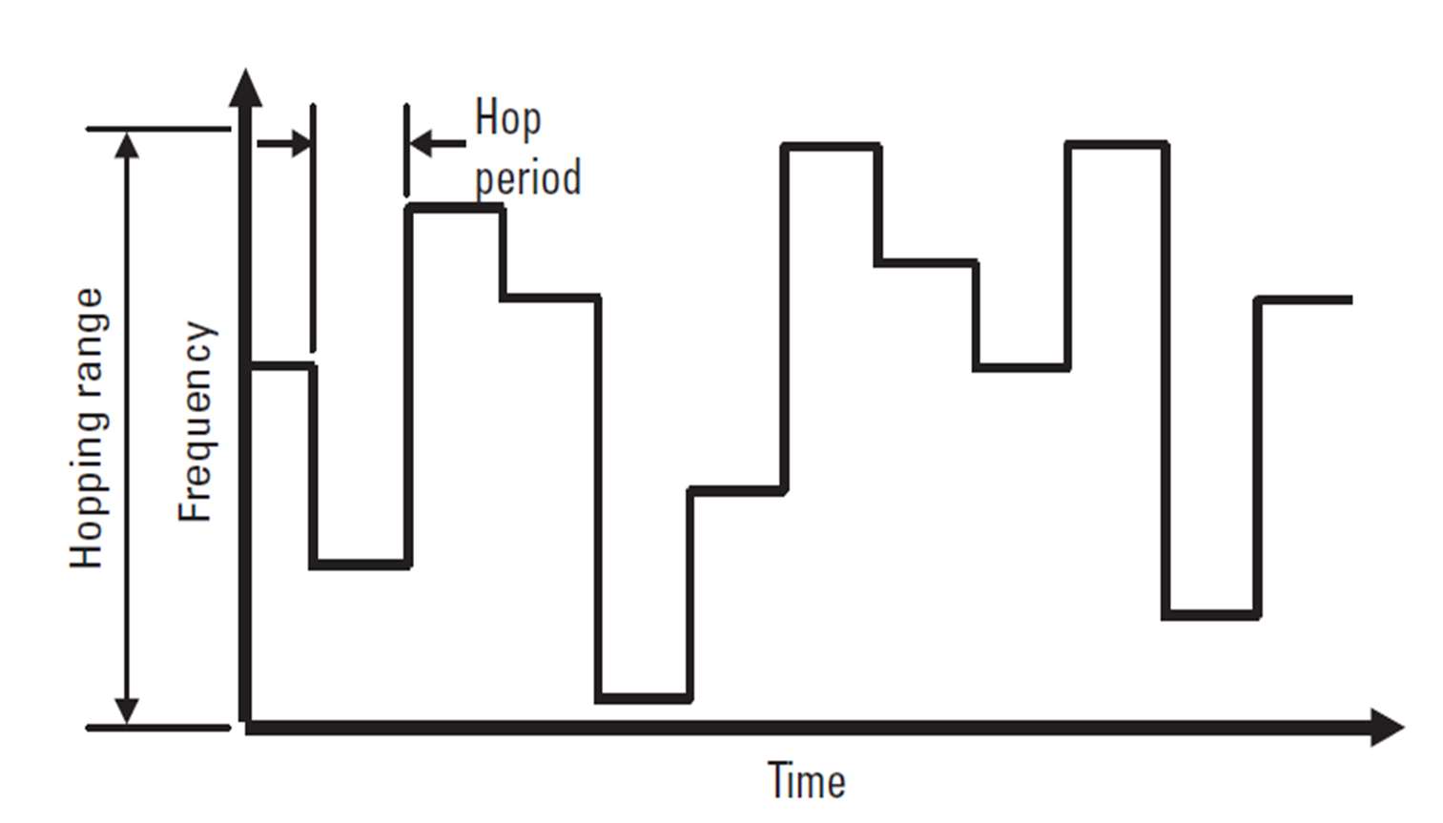

Slide 26
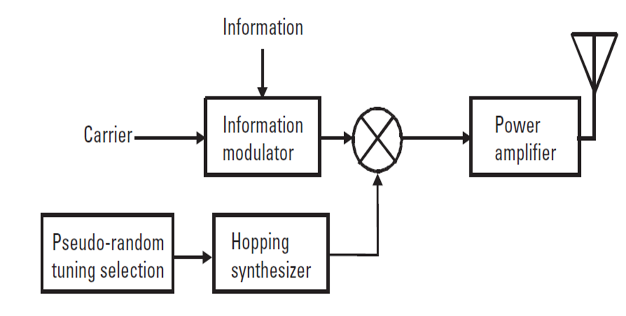

Slide 27
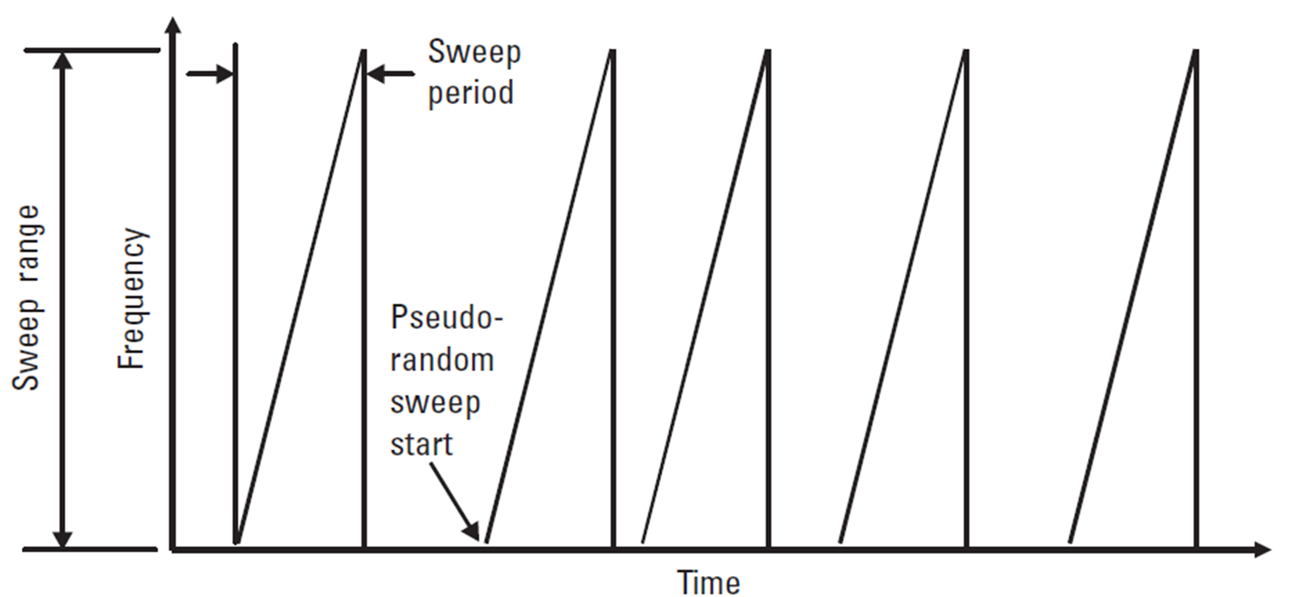

Slide 28
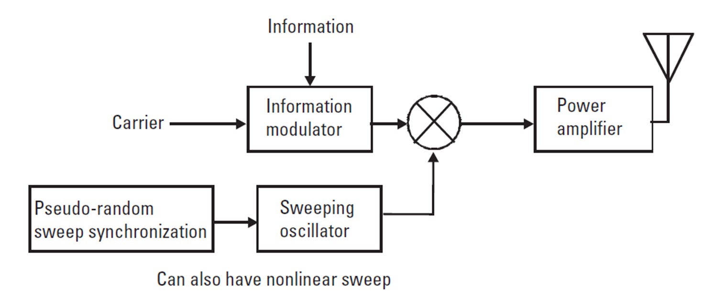

Slide 29


Slide 30
Thanks

